Slide 2
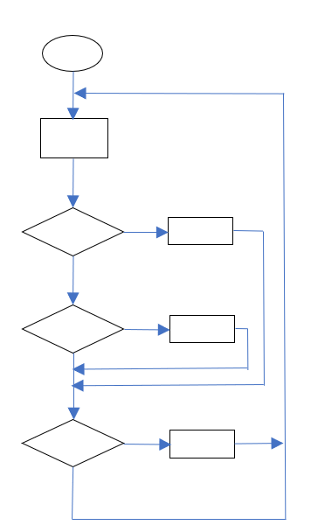
START
Go straight
If
Turn left
If
true
Turn right
false
true
Go back
false
If
true
(S0 S1 S2 S3 S4 S5 S6 S7
false

Slide 3
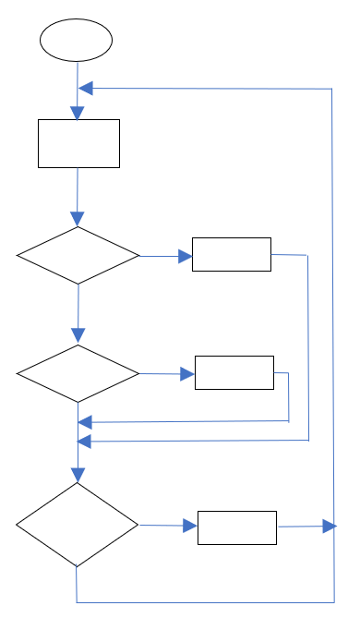
START
Go straight
If
true
Turn left
(S0 or S1 or S2)
> 300
false
If
true
(S5 or S6 or S7)
Turn right
> 300
false
If
true
(S0 & S1 & S2 & S3
Go back
& S4 & S5 & S6 & S7)
> 300
false

Slide 4
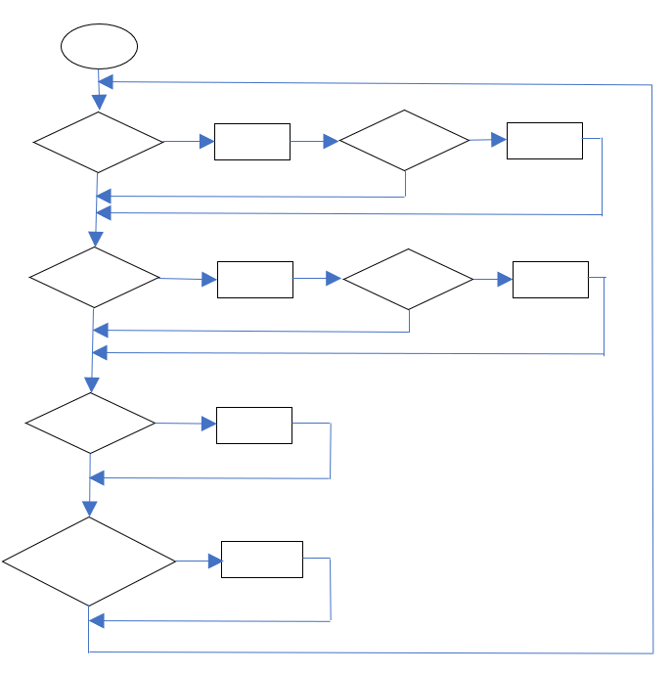
START
true
Go straight
If 10 < S0 < 50
Stop
If S0 < 50
false
false
If S0 > 50
true
Go back
If 10 < S0 < 50
Stop
false
false
If
true
(S1 or S2 or S3)
Turn right
> 60
false
If
true
(S4 or S5 or S6)
Turn left
> 60
false

